Slide 1
Foundations of Complex Software Architectures and Styles
Damian A. Tamburri, Ph.D.
damianandrew.tamburri@polimi.it
dtamburri@acm.org

Slide 2
Where were we?
We defined SAs & the process of obtaining them (a.k.a., sw. design);
Sound Design means exercising sound design principles ➔ these reflect in the code!
We started project & community browsing...
Or didn’t you??? ☹

Slide 3
Where were we?
We defined SAs & the process of obtaining them (a.k.a., sw. design);
Sound Design means exercising sound design principles ➔ these reflect in the code!
We started project & community browsing...
Or didn’t you??? ☹ ➔
One issue about this – it is no longer possible to openly join UniMoSA without an invite, send me GitHub IDs of team members, project you’d like to investigate and Iìll invite you!

Slide 4
Structure of The Lecture
Let’s look at design from a different perspective:
What does it mean?
Design of what?
Just what is Design?
Bad Decision = Technical Debt
The “long future” of (software) design
Revisiting Software Architecture
*Thanks to Richard N. Taylor & André van der Hoek –
University of California, Irvine
Notes:
Should be 3:00 minutes in.

Slide 5
Hic jacet Arturus, rex quondam, rexque futurus
Geoffrey of Monmouth, 12th century
Notes:
So let’s begin with the subtitle: The once and future focus of software engineering.
You can see from this slide, if you can read Latin, that the subtitle is a take off of this claimed epitaph for King Arthur
“Here lies Arthur, the once and future king’ The point is this: design was at the very center of the earliest work in software engineering, and we claim is, and will remain, the center.
It seems as though Design has lost some of its appropriate prominence as SE settled into a pattern of conferences & specialities
Our contention is that Design is properly the prime focus of SE, and should regain that prominence.

Slide 6
Hic jacet Arturus, rex quondam, rexque futurus
Geoffrey of Monmouth, 12th century
“Here lies Arthur, the once and future king’
Notes:
So let’s begin with the subtitle: The once and future focus of software engineering.
You can see from this slide, if you can read Latin, that the subtitle is a take off of this claimed epitaph for King Arthur
“Here lies Arthur, the once and future king’ The point is this: design was at the very center of the earliest work in software engineering, and we claim is, and will remain, the center.
It seems as though Design has lost some of its appropriate prominence as SE settled into a pattern of conferences & specialities
Our contention is that Design is properly the prime focus of SE, and should regain that prominence.

Slide 7
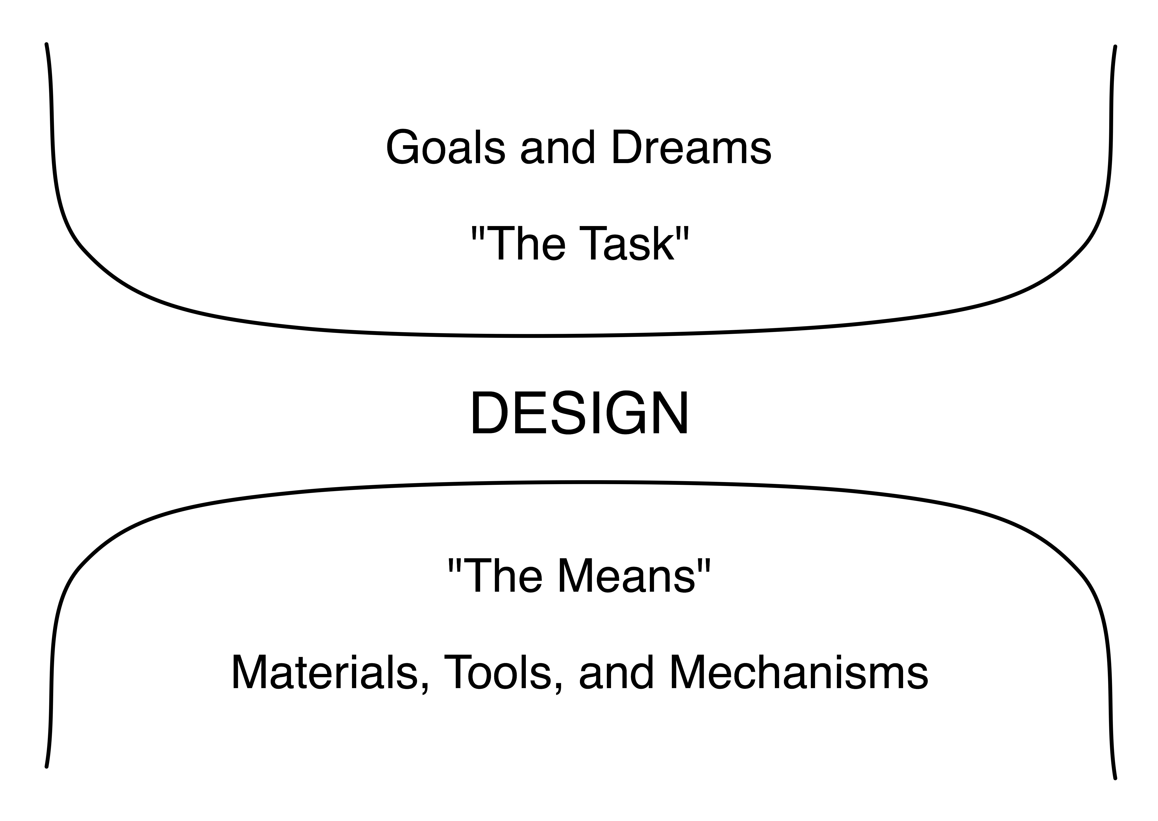
Design is at the Center of SE
Notes:
The purpose of SE is to produce new applications. New products. That involves design.
This is the essence of our task.
Herb Simon. Sciences of the Artificial
(Materials: concepts, languages, ways of thinking
Tools: specific embodiments of approaches
Mechanisms: processes and algorithms

Slide 8
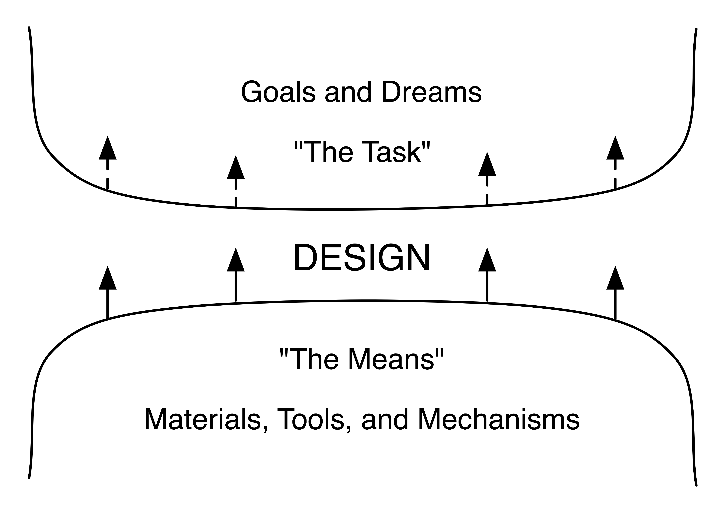
Design Will Remain the Center
Notes:
Regardless of how far we advance SE techniques, design will always be at its heart.
The intrinsic challenges will be:
How to create artifacts to meet goals
How to represent new conceptions
How to analyze them
Y-axis: sophistication/ambition for applications
Should be 6:00 minutes in.

Slide 9
Consequences
We can always stay gainfully employed!
Design provides a guiding star for:
Our educational practices
Our research emphases
Essence vs. accident: as we center on the former, design becomes pre-eminent
Our characterization of what we do to outside parties
Design will remain as a worthy subject of study
Notes:
Why make this point? (It just seems in the last decade or so, we’ve been more focused on the accidents of SE, rather than its essence.)

Slide 10
Design of What?
Past and current software design research
Prescriptive design methods, Notations, The wisdom of experience, HCI design, Design outside of software, Cognitive and social strategies
Agile methods, Aspect-oriented design, Design analysis, Component-based design, Software architecture
Point: almost all are focused on structure of software
Design in other disciplines (automotive, architectural, fashion, consumer products)
∃ at least as much emphasis on appearance and behavior -- perhaps more so.
We need to focus on design of structure and appearance and behavior
Notes:
Now let’s turn to the second of my three simple questions: Design of what?
The paper has two major sections, covering past emphases regarding design in software engineering, and current emphases. They are listed here.
The point is that almost all of these emphases are direct to the STRUCTURE of software.
The contrast is with design disciplines that teach new designers how to focus on the appearance and behavior of new products.
We need to focus on developing techniques that not only help us design and assess the structure of software, but techniques that help us design and assess functionality: both appearance and behavior.
An illustration or two from other disciplines will help explain my point.

Slide 11
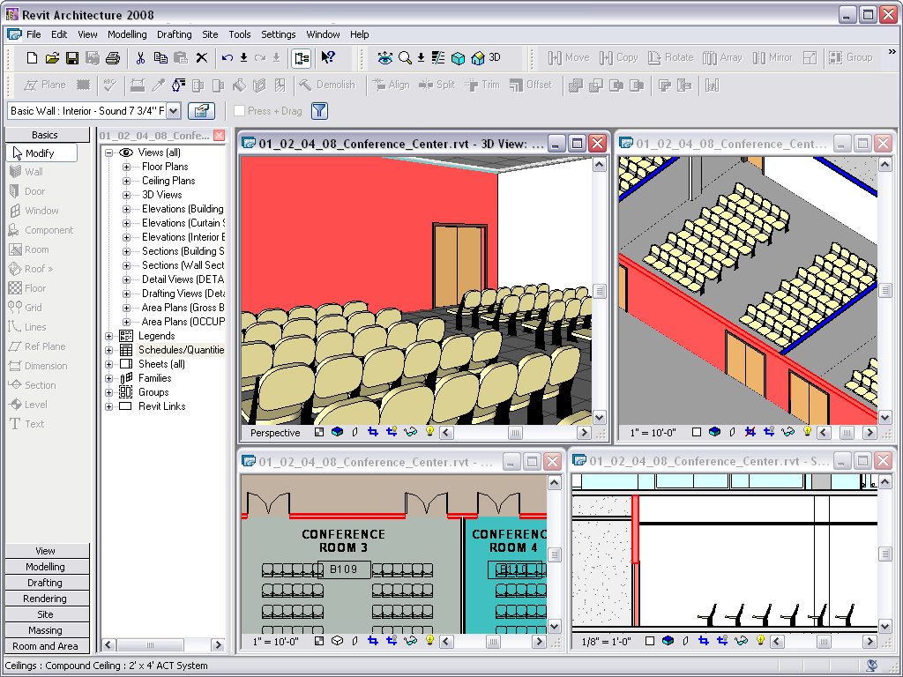
Notes:
AutoCAD’s Revit Building Information Management tool
Slides illustrate a CONFERENCE CENTER

Slide 12
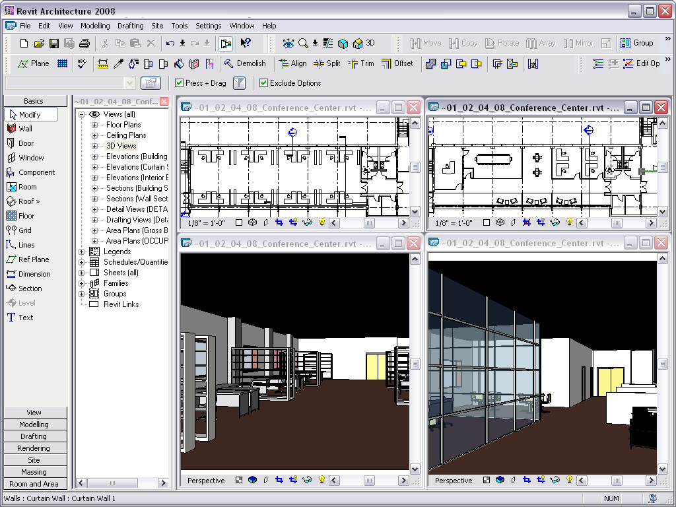
Notes:
Easier because this is static…. Ok, the point is research directions.

Slide 13
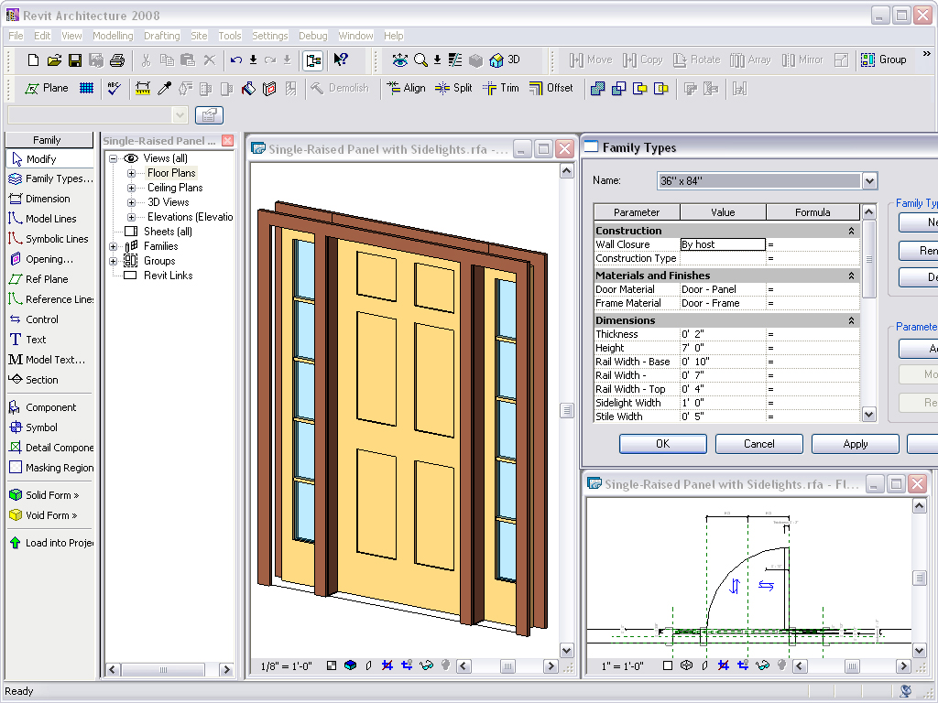

Slide 14
Application Design v. Software Design
Is this a false dichotomy?
The software engineering literature seems pretty one-sided…
Is it just HCI v. software design?
What issue predominates in the following:
An airline reservation website
Mashups (dynamically composed web apps)
GoogleEarth
If it is not our job to design applications, who’s job is it?
Notes:
Is there a difference between application design and software design?
Part of the confusion is teased out on the next couple of slides.

Slide 15
When Does Design Happen?
Simple test: When is the user interface to an application designed in your favorite software process?
A problem: we still speak of “requirements, then design”. But design is being done in “requirements” -- much of the time.
But if you don’t treat it as design you’ll likely do a poor job of it
Kudos to the agile movement for the right focus here.
Notes:
If, for example, you say that requirements are the complete input-output specifications for the system to be built, then the UI has to be specified as part of the requirements.

Slide 16
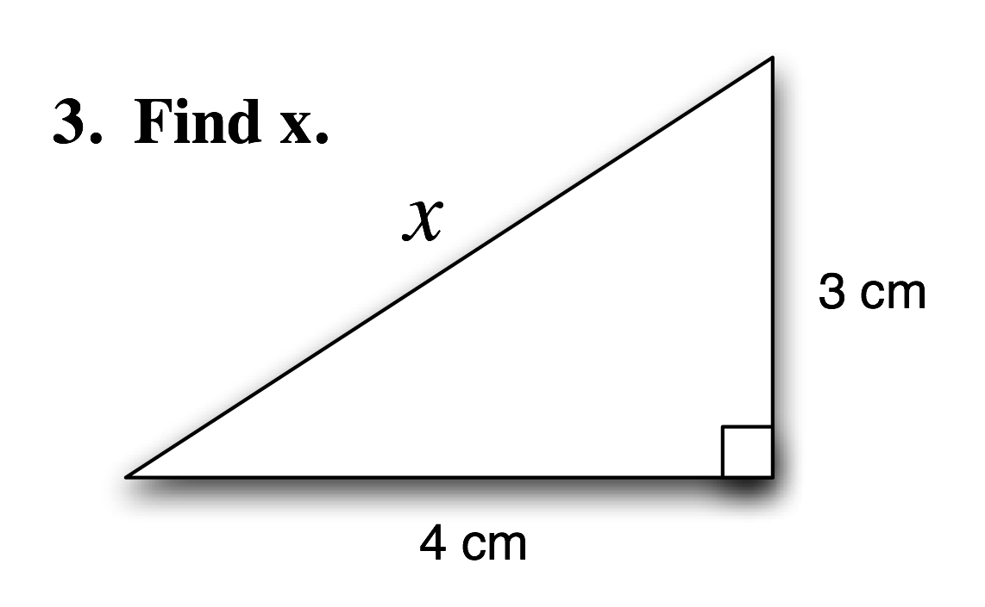
Where Did We Go Wrong?
First, a little test from a Math class:

Slide 17
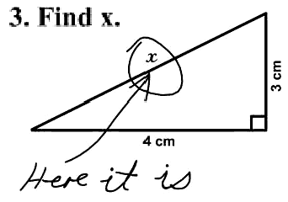
One Student’s Answer….

Slide 18
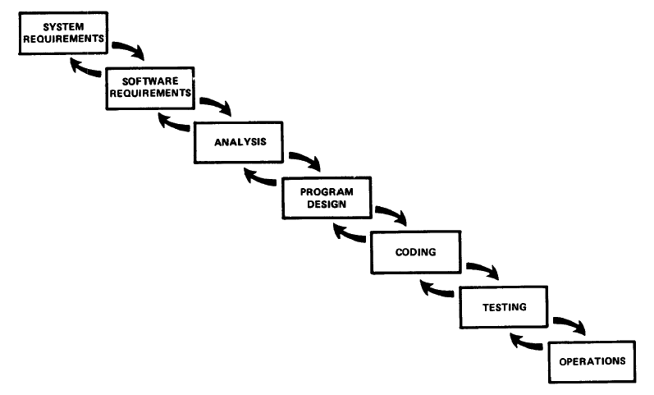
Find Design
[From W. Royce’s 1970 paper]

Slide 19
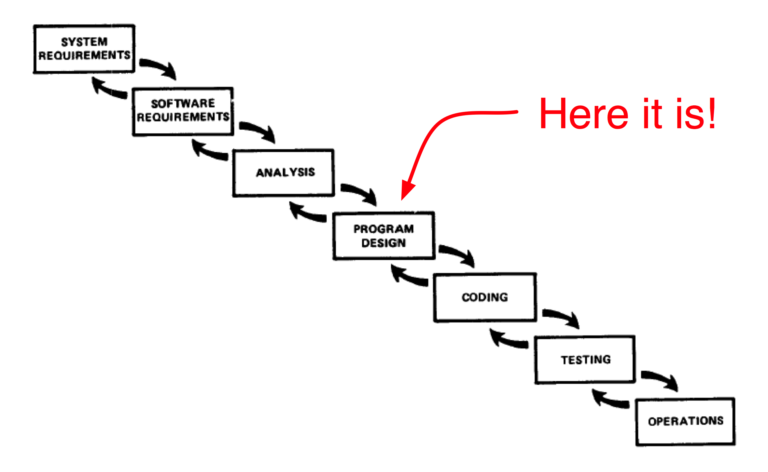
Find Design

Slide 20
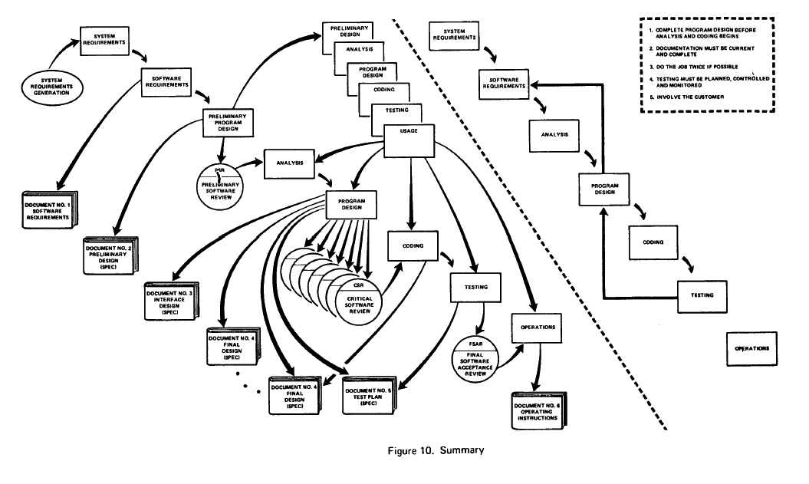
Or Here?
[From W. Royce’s 1970 paper]

Slide 21
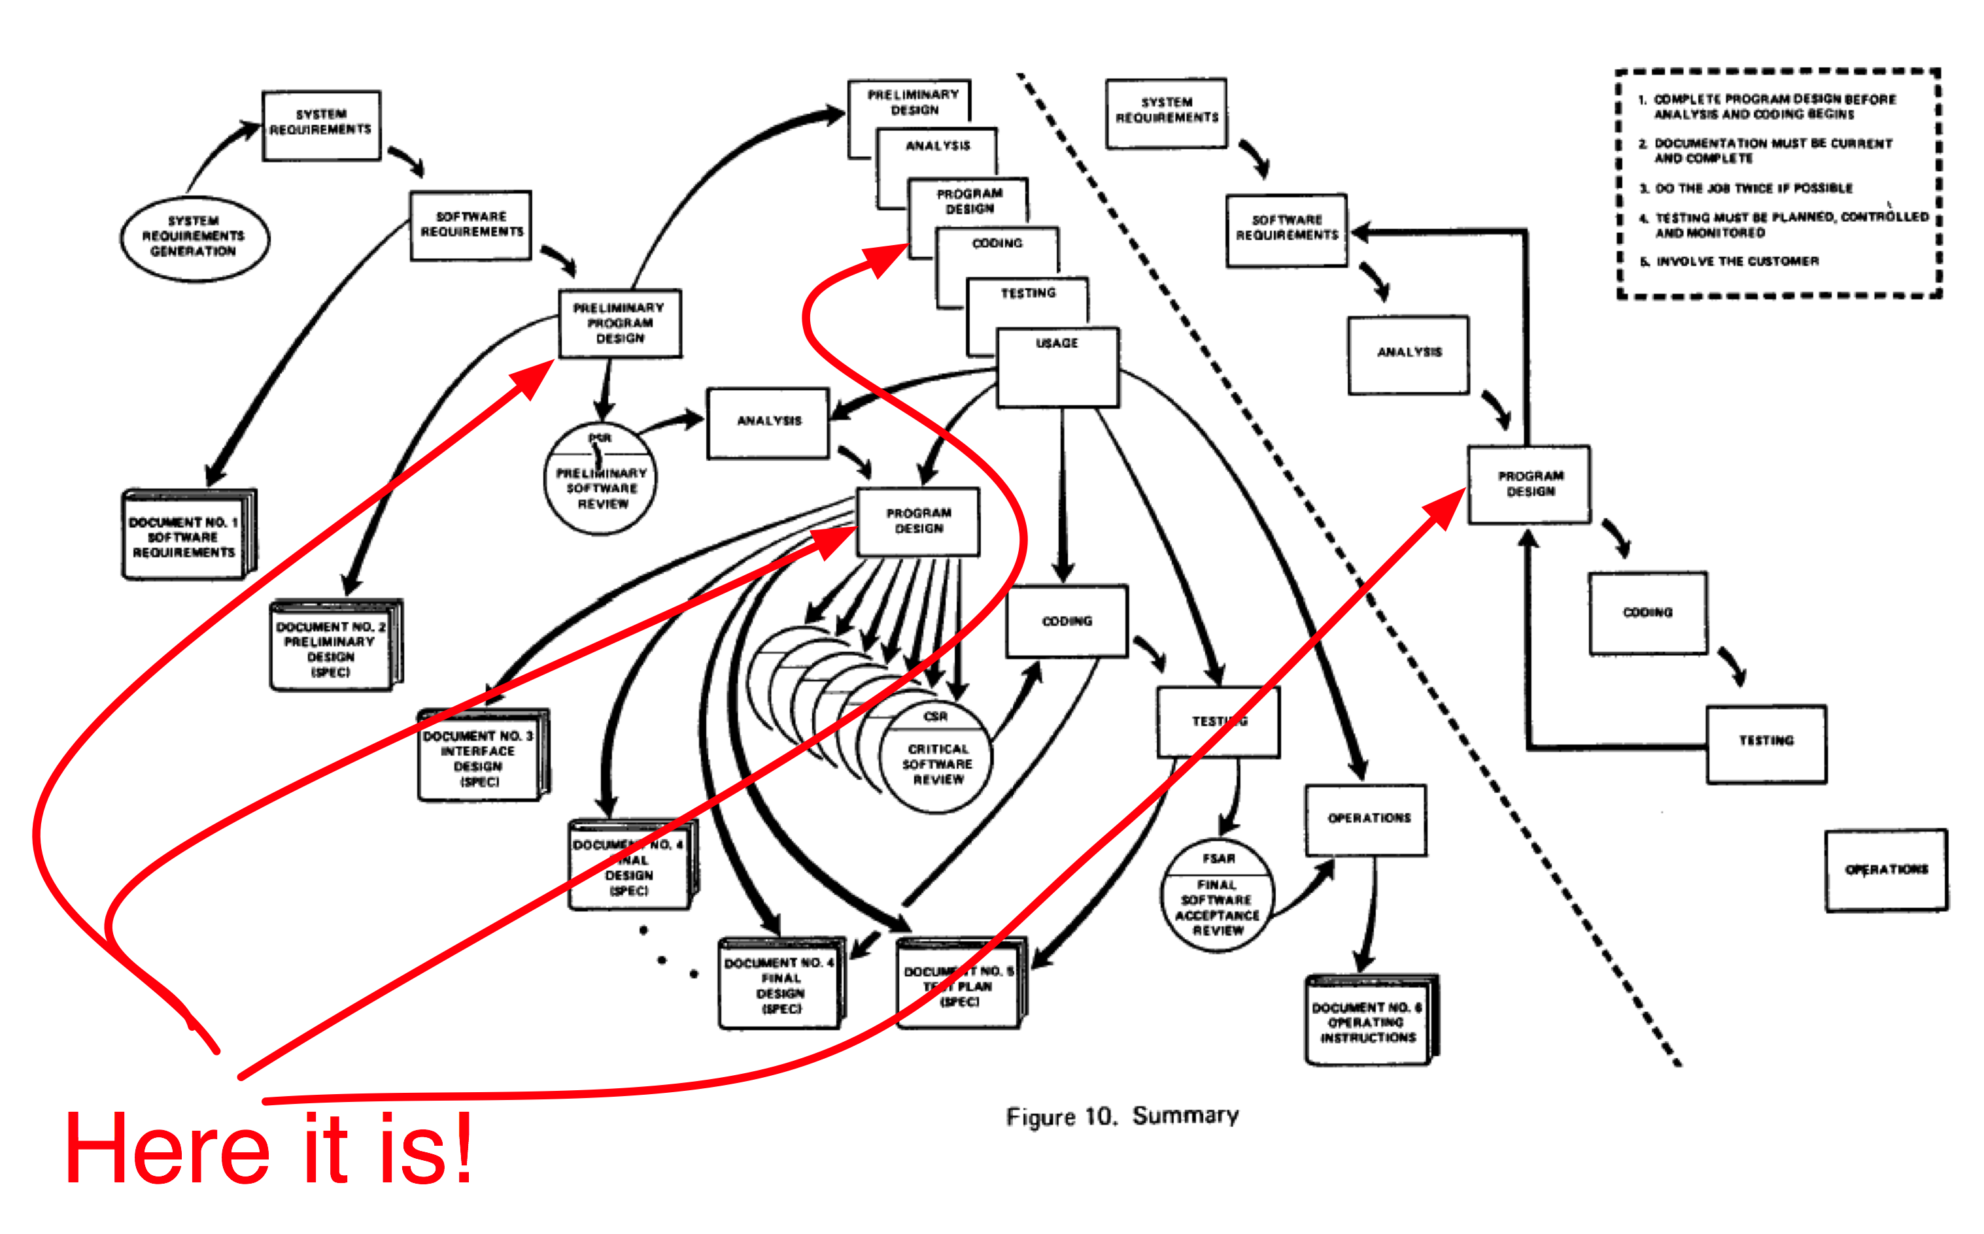
Or Here?

Slide 22
This Early Work Misled Us
When one thing is labeled “Design” or “Preliminary Design” that implies that those things that are NOT so labeled are NOT design
Especially when some of those other things are indicated as predecessors of Design
Notes:
Transition to next slide: So what’s the point? Or, what’s “A” point?

Slide 23
Requirements Engineering Involves Designing
Notes:
So What? What’s the point? So, e.g., by following design processes during ‘requirements’ you end up with a much better thing -- than just the “no solution thought” RE approach would yield.
Build, explore, mimic, use standard solutions, styles, components. No need to feel guilty: rather give attention to designing the function, behavior, and appearance.
Treat the design of those characteristics of a product as carefully as you will the design of the structure.
How to well-design appearance and behavior and structure remain research challenges for us.

Slide 24
Just What is Design?
Design is Decision Making
Decisions of how to accomplish something
Decisions of how to represent something
A solid approach to design should offer a solid approach to decision making
What are they?
Capturing them, and their rationale
Recognizing them when they are made, in the context
Analyzing, contrasting, and managing alternatives
Reflecting upon them to improve future designs (future decision making)
Distilling them into practical, reusable design knowledge
Notes:
Going on the 3rd of my little questions.
The paper offers definitions and covers many areas… for now I’d just like to focus on one key aspect
Capturing designs; Herbsleb’s question. You will do it when there’s a benefit. When the decision-making is intrinsic to the process; when value is derived from it. And that will happen in product families. Preserve the context of the decision making --- keyed to artifacts.
Layers. Alternatives. Time-based change.
Elements of design research
The community of designers

Slide 25
Architectural design decisions
Architectural design is a creative process so the process differs depending on the type of system being developed.
However, a number of common decisions span all design processes.

Slide 26
Architectural design decisions: Examples
Is there a generic application architecture that can be used?
How will the system be distributed?
What architectural styles are appropriate?
What approach will be used to structure the system?
How will the system be decomposed into modules?
What control strategy should be used?
How will the architectural design be evaluated?
How should the architecture be documented?

Slide 27
Good Decision Techniques
Using priorities and objectives to decide among alternatives:
Step 1: List and describe the alternatives for the design decision.
Step 2: List the advantages and disadvantages of each alternative with respect to your objectives and priorities.
Prior to starting a design effort, main objectives and ‘priorities’ should be made clear.
Objectives need to be measurable (e.g. Non-functional requirements and a host of other examples…)
Step 3: Determine whether any of the alternatives prevents you from meeting one or more of the objectives.
If none prevent us from accomplishing the objectives…
If ALL prevent…
Step 4: Choose the alternative that helps you to best meet your objectives.
Step 5: Adjust priorities for subsequent decision making.
© Lethbridge/Laganière 2001
26 Chapter 9: Architecting and designing software

Slide 28
Priorities & Objectives: an Example
Imagine a system has the following objectives, starting with top priority:
Security: Encryption must not be breakable within 100 hours of computing time on a 400Mhz Intel processor, using known cryptanalysis techniques.
Maintainability. No specific objective.
CPU Efficiency. Must respond to the user within one second when running on a 400MHz Intel processor.
Network Bandwidth Efficiency: Must not require transmission of more than 8KB of data per transaction.
Memory Efficiency. Must not consume over 20MB of RAM.
Portability. Must run on Windows 7 or 8, and Linux
© Lethbridge/Laganière 2001
26 Chapter 9: Architecting and designing software

Slide 29
Making a Choice: Cost-Benefit Analysis
To estimate the costs, add up:
The incremental cost of doing the software engineering work, including ongoing maintenance
The incremental costs of any development technology required
The incremental costs that end-users and product support personnel will experience
‘Incremental costs’ refers to the extra costs involved if this option is selected.
“The software engineering cost is proportional to the amount of time spent by software engineers, commonly measured in person-days or person-months. Most organizations convert this into monetary terms by multiplying by a factor that accounts for the average salary plus other costs associated with employing a person, such as their office space.”
To estimate the benefits, add up:
The incremental software engineering time saved
The incremental benefits measured in terms of either increased sales or else financial benefit to users
© Lethbridge/Laganière 2001
26 Chapter 9: Architecting and designing software

Slide 30
Bad Decision? Technical Debt!
Debt : “a sum of money that is owed or due.”

Slide 31
Bad Decision? Technical Debt!
Debt : “a sum of money that is owed or due.”
Technical Debt “a sum of money that is owed or due connected to a technical loan.”

Slide 32
Bad Decision? Technical Debt!
Debt : “a sum of money that is owed or due.”
Technical Debt “a sum of money that is owed or due connected to a technical loan.”
Technical Debt in Software Engineering:
“a sum of money that is owed or due because of a technical loan in the source-code, architecture, etc.”

Slide 33
Some Familiar Experiences
As the software evolves, costs are rising and customer responsiveness is falling.
Using an obscure/incomplete error message because it is too hard to figure out how to do it right.
Rushing for a shippable product to meet to contract so getting something done in its own way.
After a couple of years, the system is paralyzed and so it is even cheaper to develop a new one from scratch.
CSSE

Slide 34
Technical Debt: Definitions
The cost associated with a lesser software system that became difficult to maintain and improve. The debt within the system becomes a constant anchor on software productivity and impedes the ability to efficiently add new features. [3]
Delayed technical work that is incurred when technical short cuts are taken, usually in pursuit of calendar-driven software schedules. Just like financial debt, some technical debts can serve valuable business purposes. [1]
CSSE

Slide 35
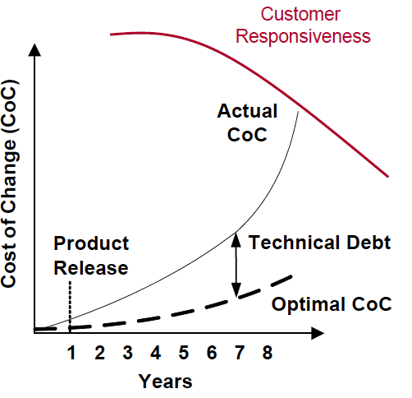
Technical Debt: Definitions
Technical debt in two axis:
Reckless/prudent & Deliberate/Inadvertent[2]
Reckless-deliberate: “we do not have time for design.”
Reckless-inadvertent: “What is layering?”
Prudent-deliberate: “We must ship now and deal with consequences.”
Prudent-inadvertent: “Now we know how we should have done it.”
CSSE

Slide 36
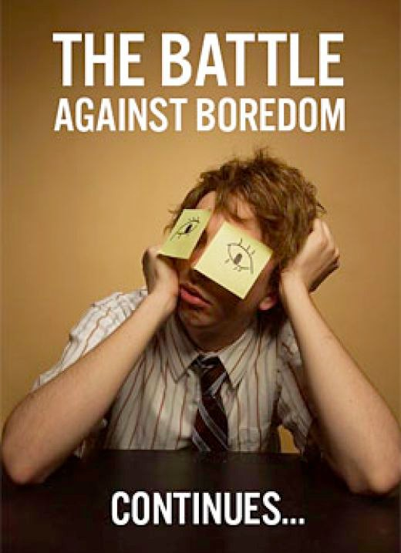
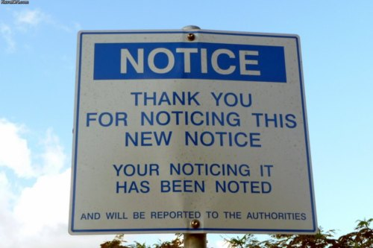
Bored yet?
10 min Break?
Coming up, technical debt symptoms!

Slide 37
Technical Debt: Symptoms
Poor customer responsiveness
Management – customers
Long delivery times
For new releases, time-to-market
Late deliveries
Time consuming bug fixes
Lots of defects
Major portion of development capacity goes to defect fixing
Rising Development Costs
Higher man-hours, higher costs
Frustrated and Poor Developer Teams
Clash between rushing for deadline – “doing it right” [1]
CSSE

Slide 38
Technical Debt: Metrics
Questions to answer for eliminating existing debt & preventing future debt[3]
How can I efficiently measure how much debt I already have?
What aspect of debt in my code are impacting me the most, or should I be most concerned about?
How much debt is “too much”; how much is “manageable”?
How much will it cost me to get out from under my high interest debt?
To characterize and to measure the existing debt related to project.
Static and dynamic tools are on service. (i.e. Sonar) [4]
CSSE

Slide 39
Technical Debt: Technical Smells!
Duplicate code (Static)
Rules Compliance
Comments – Interfaces (Static)
Comments – General (Static)
Package Interdependencies (Static)
Method/Class Complexity (Static)
Automated Test Coverage (Dynamic)
Manual Test Coverage (Dynamic) [3]
This list of metrics also represent the priority to capture.
CSSE

Slide 40
Technical Debt: Perspectives
Customers:
Biggest victims in this affair. However; they usually give more credit on features than the long-term maintainability, security and reliability. Particular customers are in a different case.
Help Desk:
Personnel in this branch suffer from almost every aspect of technical debt (poor interface, lack of documentation, slow performance…) Even though, they do not have direct access to solve the problem.
Operations:
Especially in service-oriented business; this branch pay for the outcomes of decision-makers. Recently emerged “DevOps” approach (Operations people and developers work together) [2]
CSSE

Slide 41
Technical Debt: Perspectives
Engineers:
Developers (implement the code) and maintainers (repair, modify, extend the existing code). It is perceived as developers and strongest yet maintainers do the hardest job.
Marketing:
Customer facing people; usually must deal with the displeasure of the customers in the cases of technical debt. Long release intervals push force them against customers. (No need to mention about the situations in which the new release does not work properly.)
Management:
Conducting good risk management and balancing demands from different branches & Favor a single branch/department and neglect the others which leads taking too much technical debt or missing the advantage of taking a right amount. [2]
CSSE

Slide 42
Paying Back the Debt
Engagement, motivation and a plan lead exponential value to customers.
Engaging executive management in explaining what technical debt is.
Explaining how it is impacting responsiveness, costs, delivery and morale.
Getting buy in to make the necessary investments to pay down technical debt and proactively manage it going forward.
Creating a realistic plan and appropriate governance model[1]
When interacting with high rank executives; it would help to explain technical debt as analogous to financial debt.[1]
CSSE

Slide 43
Technical Debt: Repayment Strategies
After tracking technical debts in a project by using related metrics and forming a repayment plan
Poor coding and testing practices:
Often conducts from lack of time and/or knowledge to do it right. Each team member should invest in their own knowledge and education on how to write clean codes, related business domain and how to do their jobs optimally. [1]
Poor system design:
Most architects over-focus on user features and under-focus on the actual important qualities of a software like maintainability, performance, reuse and adaptability which directly relate to the technical debt.[1]
Poor Communication and Collaboration
Directly related to technical debt. At least a daily stand-up meetings (15 minutes at max) for entire team to synchronize each member’s schedule. People can adjust and collaborate on accomplishing important tasks.[1]
CSSE

Slide 44
Technical Debt: Repayment Strategies
After tracking technical debts in a project by using related metrics and forming a repayment plan
Lack of standard development processes:
Companies often use a blended way of their own instead of a proven method in which cases documentation does not reflect how it is done in practice. [1]
Poor requirements with no common definition of done:
For each requirement, use case and user story there should be a common definition of done which must be validated with management before and after development phase. [1]
Lots of manual effort for a release:
A few team members who are fully focused on automated tools can accomplish a great deal of integration / testing / database setup work in a relatively short time.
Lack of proactive investment in paying down debt:
Sometimes technical debt should be taken on only with a conscious decision (not recklessly) Management side must have good deal of knowledge about technical debt and tackling it. [1]
CSSE

Slide 45
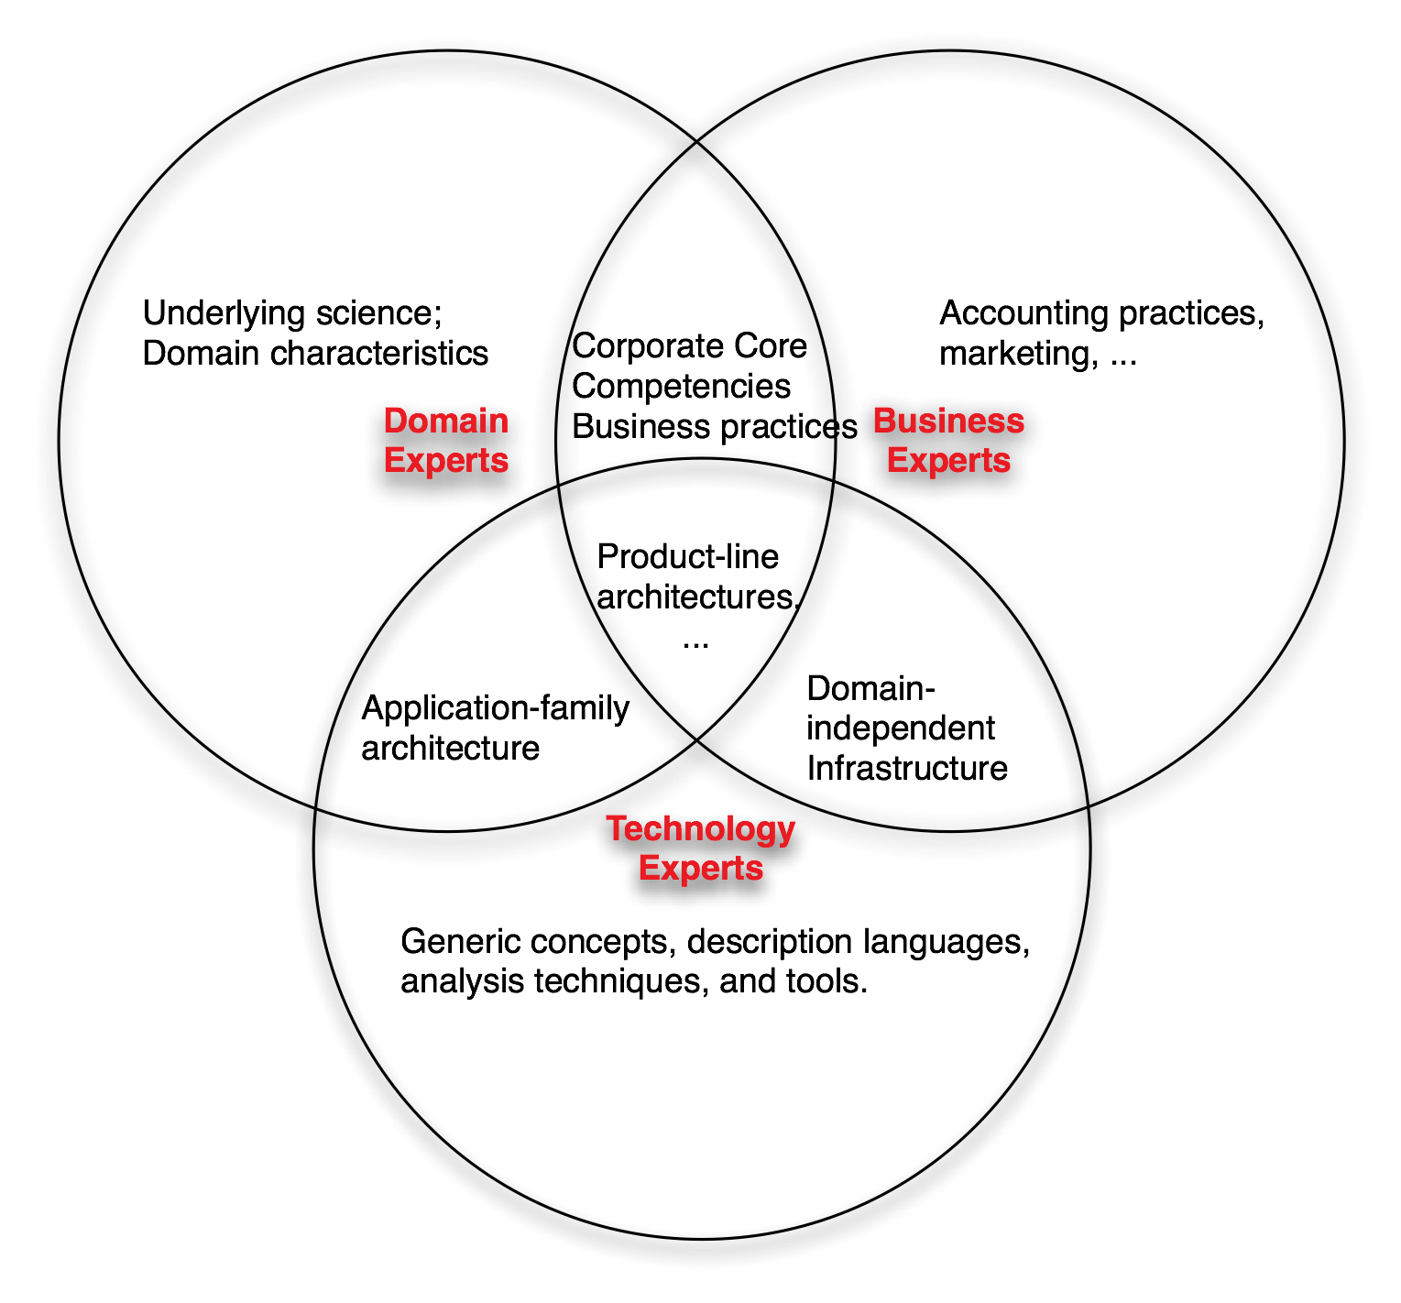
Enough with this Debt metaphor... Who is responsible?
The software engineers
The “software designers”
The “requirements engineers”
The “implementers”
The product/business strategist/analyst
Domain experts
Example: product-line architectures
Notes:
Should be at 18:00 at end.

Slide 46
Decision Makers?
The software engineers
The “software designers”
The “requirements engineers”
The “implementers”
The product/business strategist/analyst
Domain experts
Example: product-line architectures
Notes:
Should be at 18:00 at end.

Slide 47
Decision Makers?
The software engineers
The “software designers”
The “requirements engineers”
The “implementers”
The product/business strategist/analyst
Domain experts
...
All of them.
Notes:
Should be at 18:00 at end.

Slide 48
Decision Making: When Does it Happen?
You guessed it:
Throughout *all* system’s lifetime
Conception
Detailed architecture
Implementation (think of the impact of choosing an implementation framework)
Adaptation
Why does this matter?
Because these decisions matter -- and should be treated with equivalent care and be part of the design documentary

Slide 49
A Design Imperative
What’s key in making explicit software structural design essential, credible -- and not busy work:
Full, traceable tie to implementation.
Works in low-level (structural) design (UML)
Works in generative approaches to system design/implementation
We must make it work more broadly.
Notes:
Deletion candidate

Slide 50

The Long Future
Co-design of software and organizations
Software designers as the skilled designers of other intangible products
The driving experience
Commerce
Law
…
Notes:
Make the point that as we change the definition of software (the thing designed) that the techniques may need to be changed, or new techniques developed.

Slide 51
Conclusions (for this part)
What’s design?
Design is the central focus of software engineering
Design of what?
We design structure and appearance and behavior, and do it throughout
Just what is Design?
Designing involves decision-making by more than just software engineers -- and requires support

Slide 52
Software Architecture Revisited
The set of principal design decisions about a system
Design decisions encompass every aspect of the system under development, including:
design decisions related to system structure – for example, “the architectural elements should be organized and composed exactly like this”,
design decisions related to behavior – for example, “data processing, storage, and visualization will be handled separately”,
design decisions related to interaction – for example, “communication among all system elements will occur only using event notifications”, and
design decisions related to the system’s non-functional properties – for example, “the system’s dependability will be ensured by replicated processing modules.”
Design decisions can exist across the spectrum of detail.
Stakeholders determine what is principal

Slide 53
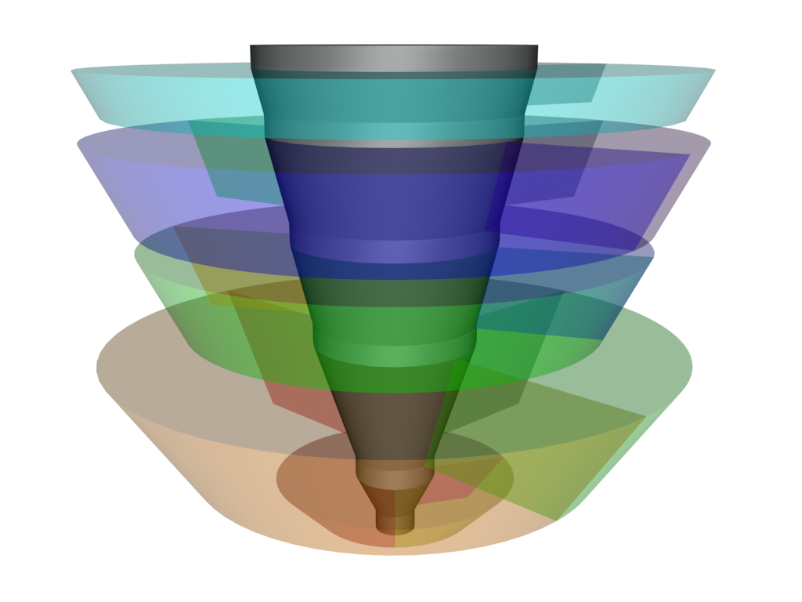
Turbine Visualization of Processes
Assess/…
Test/Build/
Deploy
Build/Design/
Requirements/Test
Design/Build/
Requirements
Requirements/Architecture
assessment/Planning
Notes:
Rotor 1: Reqts 50%; Architecture assessment 30%; Project planning 20%.
Rotor 2: Design: 50%; Impl. 25%; Reqts 12.5%; Other 12.5%
Rotor 3: Design 15%; Impl. 50%; A&T: 25%; Reqts 5%; Other 5%
Rotor 4: Impl. 15%, A&T 50%; Deployment 20%; Other 15%
Rotor 5: Analysis of lessons learned: 85%; Other 15%
GAP rotor (i.e. some amount of the core sticks out above the top rotor

Slide 54
The Science of Design
Design Sciences
(e.g. Software design)
Engineering
Descriptive Sciences
(e.g. Biology, Astronomy)

Slide 55
How About re-design?
Situations in which the design evolves:
Intentional or not
Explicit or implicit
Constant is change of decision

Slide 56
Design evolution techniques
Different types of scenarios one may use in architecture assessments:
Use cases : these often are already available, or can be derived from the requirements.
Change cases : change cases describe possible or likely future situations. They describe ”what-if” like situations, like ”what if our library has to be able to handle dvd’s next to books and journals”.
Stress situations : these describe extreme conditions under which the system still has to operate, such as limits with respect to performance or the number of concurrent users of the system.
Far-into-the-future scenarios : these are like change cases, but farther away. For instance, we may envision a future in which a library changes from a document archive to a memory archive. We may want to retain how an old-fashioned bakery smells, or the sound of a San Francisco tram.

Slide 57
ATAM: the Architecture Tradeoff Analysis Method
Goal of ATAM is to determine how quality attributes interact.
Example1: If we decide to include an authorization component to increase security, such is likely to degrade performance.
Example2: If we add redundancy to increase availability we increase cost and (possibly) degrade performance
By making the consequences of design decisions explicit, it becomes possible for stakeholders to trade off the different possibilities, and make informed decisions, with clear insight into the consequences thereof.

Slide 58
Steps of ATAM
1. Present method to stakeholders
2. Present business drivers (by project manager)
3. Present architecture (by lead architect)
4. Identify architectural approaches
5. Generate quality attribute tree
6. Analyze architectural approaches
7. Brainstorm and prioritize scenarios
8. Analyze architectural approaches
9. Present results
Notes:
There may be a preparatory
phase in which participants meet to discuss the whole exercise, and a follow-up phase
at the end in which a written report is delivered. The first steps are meant to make
the participants familiar with the major quality drivers for the system (step 2), the
solution chosen (step 3), and the approaches and patterns used in this solution (step
4). In step 5, the quality requirements are articulated in more detail. The project˘s
decision makers are key in this process. The end result of this exercise is a tree.
The root node is termed ”utility”. It expresses the overall quality of the architecture.
The next level contains the quality attributes that will be evaluated. These are again
broken down into more detailed constituents. The leaf nodes are concrete scenarios.

Slide 59
Steps of ATAM
The end result of this exercise is a tree.
The root node is termed ”utility”. It expresses the overall quality of the architecture.
The next level contains the quality attributes that will be evaluated. These are again broken down into more detailed constituents.
The leaf nodes are concrete scenarios.

Slide 60
Steps of ATAM
It could be useful to prioritize scenarios.
ATAM suggests two criteria for doing so:
Using the first criterion, the stakeholders indicate how important the scenarios are (e.g. using a simple 3-point scale: High, Medium, Low).
Using the second criterion, the architect ranks the scenarios according to how difficult he believes it will be to satisfy the scenario, using the same 3-point scale.
In the remainder of the assessment, one may then for instance concentrate on the scenarios that score High on both scales.

Slide 61
Steps of ATAM
The end result is a documented list of sensitivity points, tradeoff points, risks and non risks, relating the architectural decisions made to the relevant quality attributes.
A sensitivity point is a property of the architecture that is critical for a certain quality attribute.
For example, the possibility to undo user actions critically affects the usability of our library system, and this property therefore is a sensitivity point with respect to usability. At the same time, this decision also is a sensitivity point with respect to performance.
If a decision is a sensitivity point for more than one quality attribute, it is called a tradeoff point.
If performance is of utmost importance, the decision to include an undo facility may be a risk. If this decision is not critical, it is a non-risk.

Slide 62
Utility Tree

Slide 63
Part of a DevOps Tool-Chain
→
Architecture effortlessly integrates with Tasktop technologies
DevOps-Readiness
Easily extends DevOps tools
→
Architecture effortlessly integrates with JIRA, BugZilla
Feature extension
→
Architecture is effortlessly extended with man-in-the-middle version control DBs
Extensibility
Methodological extension
→
Architecture effortlessly accommodates extensibility and rapid prototyping
Friendly to IT-Agnostic users
→
Architecture effortlessly accommodates inexperienced or loosely experienced users
Ease-of-use
Customizable user experience
→
Architecture effortlessly allows ad-hoc configuration of user-interaction and Level-of-control (LoC)
DICE Utility
Solution supports architecture additions
→
Architecture effortlessly allows additional services
Generalizability
Solution supports multiple usage scenarios
→
Architecture effortlessly allows domain refocus
Solution is readily implementable W.o. any tech. re-skilling
→
Architecture realization does not require tech. training
Implementation-Time
Solution is time efficient for the DICE consortium
→
Architecture realization is within the planned DICE schedule
Feasibility
Solution accommodates SME limited resources and skills
→
Architecture can be quickly configured and used by a single person
SME-Readiness
Solution is efficient and effective on small infrastructures
→
Architecture can be quickly configured and used in BYOD* organizational schemes

Slide 64
Part of a DevOps Tool-Chain
→
Architecture effortlessly integrates with Tasktop technologies
DevOps-Readiness
Easily extends DevOps tools
→
Architecture effortlessly integrates with JIRA, BugZilla
Feature extension
→
Architecture is effortlessly extended with man-in-the-middle version control DBs
Extensibility
Methodological extension
→
Architecture effortlessly accommodates extensibility and rapid prototyping
Friendly to IT-Agnostic users
→
Architecture effortlessly accommodates inexperienced or loosely experienced users
Ease-of-use
Customizable user experience
→
Architecture effortlessly allows ad-hoc configuration of user-interaction and Level-of-control (LoC)
→
Architecture effortlessly allows additional services
DICE Utility
Opt. 1
Solution supports architecture additions
Generalizability
Solution supports multiple usage scenarios
→
Architecture effortlessly allows domain refocus
Solution is readily implementable W.o. any tech. re-skilling
→
Architecture realization does not require tech. training
Implementation-Time
Solution is time efficient for the DICE consortium
→
Architecture realization is within the planned DICE schedule
Feasibility
Solution accommodates SME limited resources and skills
→
Architecture can be quickly configured and used by a single person
SME-Readiness
Solution is efficient and effective on small infrastructures
→
Architecture can be quickly configured and used in BYOD* organizational schemes

Slide 65
Part of a DevOps Tool-Chain
→
Architecture effortlessly integrates with Tasktop technologies
DevOps-Readiness
Easily extends DevOps tools
→
Architecture effortlessly integrates with JIRA, BugZilla
Feature extension
→
Architecture is effortlessly extended with man-in-the-middle version control DBs
Extensibility
Methodological extension
→
Architecture effortlessly accommodates extensibility and rapid prototyping
Friendly to IT-Agnostic users
→
Architecture effortlessly accommodates inexperienced or loosely experienced users
Ease-of-use
Customizable user experience
→
Architecture effortlessly allows ad-hoc configuration of user-interaction and Level-of-control (LoC)
DICE Utility
Solution supports architecture additions
→
Architecture effortlessly allows additional services
Generalizability
Solution supports multiple usage scenarios
→
Architecture effortlessly allows domain refocus
Solution is readily implementable W.o. any tech. re-skilling
→
Architecture realization does not require tech. training
Implementation-Time
Solution is time efficient for the DICE consortium
→
Architecture realization is within the planned DICE schedule
Feasibility
Solution accommodates SME limited resources and skills
→
Architecture can be quickly configured and used by a single person
SME-Readiness
Solution is efficient and effective on small infrastructures
→
Architecture can be quickly configured and used in BYOD* organizational schemes

Slide 66
Part of a DevOps Tool-Chain
→
Architecture effortlessly integrates with Tasktop technologies
DevOps-Readiness
Easily extends DevOps tools
→
Architecture effortlessly integrates with JIRA, BugZilla
Feature extension
→
Architecture is effortlessly extended with man-in-the-middle version control DBs
Extensibility
Methodological extension
→
Architecture effortlessly accommodates extensibility and rapid prototyping
Friendly to IT-Agnostic users
→
Architecture effortlessly accommodates inexperienced or loosely experienced users
Ease-of-use
Customizable user experience
→
Architecture effortlessly allows ad-hoc configuration of user-interaction and Level-of-control (LoC)
DICE Utility
Opt. 2
Solution supports architecture additions
→
Architecture effortlessly allows additional services
Generalizability
Solution supports multiple usage scenarios
→
Architecture effortlessly allows domain refocus
Solution is readily implementable W.o. any tech. re-skilling
→
Architecture realization does not require tech. training
Implementation-Time
Solution is time efficient for the DICE consortium
→
Architecture realization is within the planned DICE schedule
Feasibility
Solution accommodates SME limited resources and skills
→
Architecture can be quickly configured and used by a single person
SME-Readiness
Solution is efficient and effective on small infrastructures
→
Architecture can be quickly configured and used in BYOD* organizational schemes

Slide 67
Goal of ATAM
The utility tree is based on the main drivers used during the design of the architecture. Its construction is done in consultation with the main decision makers.
Stakeholders, including the architect, often construct a much deeper understanding of the architecture, its underlying decisions, and the ramifications thereof. Also, a better documentation is often delivered as a by product of the assessment.
ATAM is mostly for business... So...

Slide 68
Bored yet?
10 min Break?
Coming up, ADD…

Slide 69
The Need for a Principled Method
How do you actually perform design?
Performing design to ensure that the drivers are satisfied requires a principled method.
By principled, we mean a method that takes into account all of the relevant aspects needed to produce an adequate design.
A method provides guidance.

Slide 70
ADD 3.0
Architecture design is performed in a series of rounds.
Each design round may take place within a project increment such as a sprint.
Within these rounds, a series of design iterations are performed.
ADD provides detailed, step-by-step guidance on the tasks to be performed inside the iterations.

Slide 71
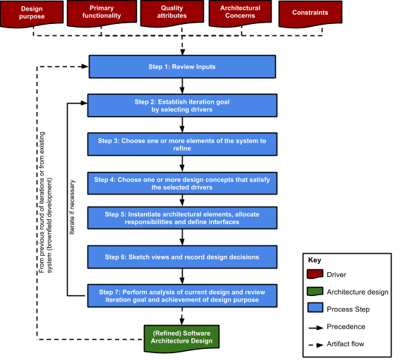
ADD’s Steps

Slide 72
Step 1: Review Inputs
Design purpose
Primary functional requirements
Quality attribute scenarios
Constraints
Architectural
Concerns
Step 1: Review Inputs
Step 2: Establish iteration goal by selecting drivers
Step 3: Choose one or more elements of the system to refine
Before starting with design, ensure that there is clarity on the overall design problem that needs to be solved.
Step 4: Choose one or more design concepts that satisfy the selected drivers
Iterate if necessary
From previous round of iterations or from existing system
Step 5: Instantiate architectural elements, allocate responsibilities and define interfaces
Step 6: Sketch views and record design decisions
Driver
Step 7: Perform analysis of current design and review iteration goal and achievement of design purpose
Architecture design
Process step
(Refined) Software architecture design
Precedence
Artifact flow

Slide 73
Step 2: Establish Iteration Goal
Design purpose
Primary functional requirements
Quality attribute scenarios
Constraints
Architectural
Concerns
Step 1: Review Inputs
Step 2: Establish iteration goal by selecting drivers
Step 3: Choose one or more elements of the system to refine
The design problem is divided into several sub-problems.
An iteration starts by deciding which sub-problem to address.
Step 4: Choose one or more design concepts that satisfy the selected drivers
Iterate if necessary
From previous round of iterations or from existing system
Step 5: Instantiate architectural elements, allocate responsibilities and define interfaces
Step 6: Sketch views and record design decisions
Driver
Step 7: Perform analysis of current design and review iteration goal and achievement of design purpose
Architecture design
Process step
(Refined) Software architecture design
Precedence
Artifact flow

Slide 74
Steps 3-5: Choose and Instantiate Elements
Design purpose
Primary functional requirements
Quality attribute scenarios
Constraints
Architectural
Concerns
3 types of decisions are made to address the sub-problem:
1. Select the parts that need to be decomposed
2. Identify and select existing solutions that support the decomposition
3. Create elements from the existing solution and establish their responsibilities and interfaces
Step 1: Review Inputs
Step 2: Establish iteration goal by selecting drivers
Step 3: Choose one or more elements of the system to refine
Step 4: Choose one or more design concepts that satisfy the selected drivers
Iterate if necessary
From previous round of iterations or from existing system
Step 5: Instantiate architectural elements, allocate responsibilities and define interfaces
Step 6: Sketch views and record design decisions
Driver
Step 7: Perform analysis of current design and review iteration goal and achievement of design purpose
Architecture design
Process step
(Refined) Software architecture design
Precedence
Artifact flow

Slide 75
Step 6: Sketch Views
Design purpose
Primary functional requirements
Quality attribute scenarios
Constraints
Architectural
Concerns
Step 1: Review Inputs
Step 2: Establish iteration goal by selecting drivers
The “blueprint” is refined. This may be done in parallel with step 5.
Note: This is not full blown documentation but rather sketches.
Step 3: Choose one or more elements of the system to refine
Step 4: Choose one or more design concepts that satisfy the selected drivers
Iterate if necessary
From previous round of iterations or from existing system
Step 5: Instantiate architectural elements, allocate responsibilities and define interfaces
Step 6: Sketch views and record design decisions
Driver
Step 7: Perform analysis of current design and review iteration goal and achievement of design purpose
Architecture design
Process step
(Refined) Software architecture design
Precedence
Artifact flow

Slide 76
Step 7: Perform Analysis
Design purpose
Primary functional requirements
Quality attribute scenarios
Constraints
Architectural
Concerns
Step 1: Review Inputs
Decisions made at this point are analyzed, along with the advances in the overall design process, to decide if more iterations are necessary.
Step 2: Establish iteration goal by selecting drivers
Step 3: Choose one or more elements of the system to refine
Step 4: Choose one or more design concepts that satisfy the selected drivers
Iterate if necessary
From previous round of iterations or from existing system
Step 5: Instantiate architectural elements, allocate responsibilities and define interfaces
Step 6: Sketch views and record design decisions
Driver
Step 7: Perform analysis of current design and review iteration goal and achievement of design purpose
Architecture design
Process step
(Refined) Software architecture design
Precedence
Artifact flow

Slide 77
ADD Output/Iteration
Design purpose
Primary functional requirements
Quality attribute scenarios
Constraints
Architectural
Concerns
Step 1: Review Inputs
Step 2: Establish iteration goal by selecting drivers
Step 3: Choose one or more elements of the system to refine
Step 4: Choose one or more design concepts that satisfy the selected drivers
The design is produced.
Note: This may be only a partial architecture design and is not Big Design Up Front!
Iterate if necessary
From previous round of iterations or from existing system
Step 5: Instantiate architectural elements, allocate responsibilities and define interfaces
Step 6: Sketch views and record design decisions
Driver
Step 7: Perform analysis of current design and review iteration goal and achievement of design purpose
Architecture design
Process step
(Refined) Software architecture design
Precedence
Artifact flow

Slide 78
Following a Design Roadmap
Design of software systems falls into three broad categories:
the design of a greenfield system for a mature (i.e. well known) domain,
the design of a greenfield system for a domain that is novel (that is, a domain which has a less established infrastructure and knowledge base), and
the design for making changes to an existing system.
Each of these involves a different roadmap: the steps you should perform in the iterations.

Slide 79
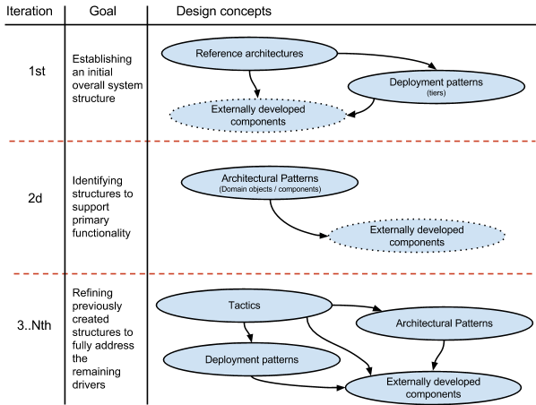
Design of greenfield systems for mature domains

Slide 80
Design of greenfield systems for novel domains
In novel domains, it is harder to establish a roadmap:
there may not be reference architectures
there may be few externally developed components.
You will need to work from first principles.
Even in this case, design concepts like tactics and patterns can still guide you, aided by prototyping.
Your iteration goals will mostly be to refine previously created structures to address the drivers.

Slide 81
Design for an existing system (brownfield)
For an existing system you may need to satisfy new requirements or correct issues
this may catalyze changes to the architecture
Or you may be making architectural changes to refactor the system to fix quality attribute problems
e.g. the system is slow, or frequently crashes, or is hard to modify.

Slide 82
Design for an existing system (brownfield)
If you understand your architecture you can perform design as with greenfield systems (after the initial design iteration).
Your iteration goals are to identify and refine structures to satisfy architectural drivers:
new functionality
quality attributes
architectural concerns
This will not involve establishing a new overall system structure, unless you are doing a major refactoring.

Slide 83
Identifying Design Concepts
There are dozens of patterns and components you could use to address any issue.
To make things worse, these design concepts are scattered across many sources—popular press, research literature, books, the internet—and described differently.
Finally, once you have identified design alternatives, you need to select among them.

Slide 84
Selecting Design Concepts
Once you have identified a list of design concepts, you need to select among them.
How?
Create a table that lists the pros and cons of each alternative and select based on your criteria and drivers.

Slide 85
Example Table to Support Selection
Name of alternative | Pros | Cons | Cost
Web application | Can be accessed from a variety of platforms using a standard web browser Fast page loading Simple deployment | Does not support “rich” interaction | Low
Rich internet application | Supports “rich” user interaction Simple deployment and updating | Longer page loading times Requires a runtime environment to be installed on the client browser | Medium
Mobile application | Supports “rich” user interaction | Less portability Screen limitations | High

Slide 86
Selecting Design Concepts
If the table isn’t enough you may need to create prototypes and collect measurements.
But creating prototypes can be costly compared to analysis.
What to do, and why?

Slide 87
To Prototype or Not to Prototype?
Questions to consider:
Does the project incorporate emerging technologies?
Is the technology new in the company?
Are there drivers, particularly quality attributes, whose satisfaction using the selected technology presents risks?
Is there a lack of evidence that the selected technology will help satisfy the project drivers?
Are there configuration options associated with the technology that need to be tested or understood?
Is it unclear whether the selected technology can be integrated with the project?
If most of your answers are “yes” you should consider a throwaway prototype.

Slide 88
Producing Structures
Design concepts won’t help you satisfy your drivers unless you produce structures
you need to identify and connect elements that are derived from the selected design concepts.
This is “instantiation” in ADD: creating elements and relationships, and associating responsibilities with these elements

Slide 89
Producing Structures
Structures are categorized as:
Module structures: elements that exist at development time, like files, modules and classes.
Component and Connector (C&C) structures: dynamic elements that exist at run-time, like processes and threads.
Allocation structures: software elements (from a module or C&C structure) and non-software elements, like file systems, hardware, and development teams.
When you instantiate a design concept you may need to produce more than one structure.

Slide 90
Defining Interfaces
Interfaces are the externally visible properties of elements which establish a contractual specification that allows elements to collaborate and exchange information.
There are two categories of interfaces: external and internal.

Slide 91
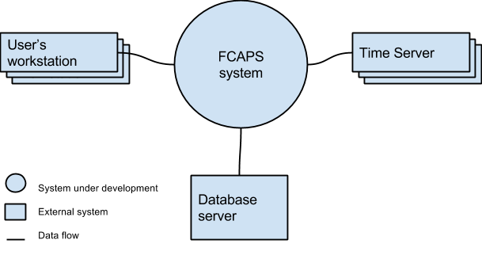
External Interfaces
External interfaces include interfaces from other systems that are required by the system that you are developing and interfaces that are provided by your system to other systems.
A system context diagram can help understand external interfaces, e.g.

Slide 92
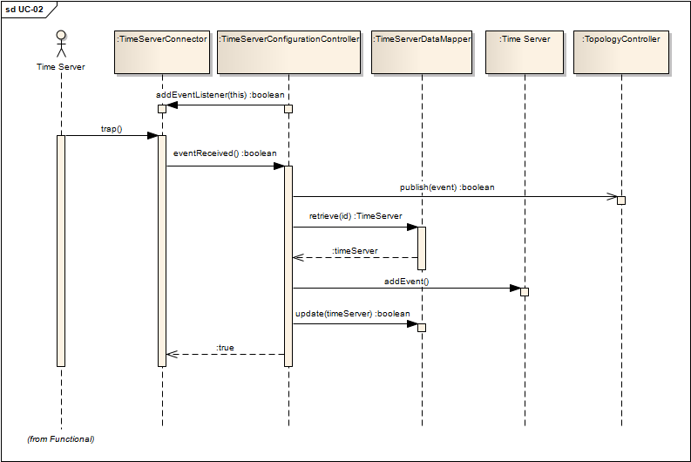
Internal Interfaces
Internal interfaces are interfaces between the elements that result from the instantiation of design concepts.
A sequence diagram can help understand internal interfaces, e.g.

Slide 93
Documenting During Design
A software architecture is typically documented as a set of views, which represent the different structures that compose the architecture.
The formal documentation of views is not part of the design process.
Structures, however, are produced as part of design.
These should be captured, even if they are informal (i.e. sketches).

Slide 94
Recording Sketches
If you use an informal notation for sketches, you should maintain consistency in the use of symbols (and add a legend to your diagrams!).
You should develop a discipline of writing down the responsibilities that you allocate to the elements as you create the structures.
Writing it down at that moment ensures that you won’t have to remember it later.

Slide 95
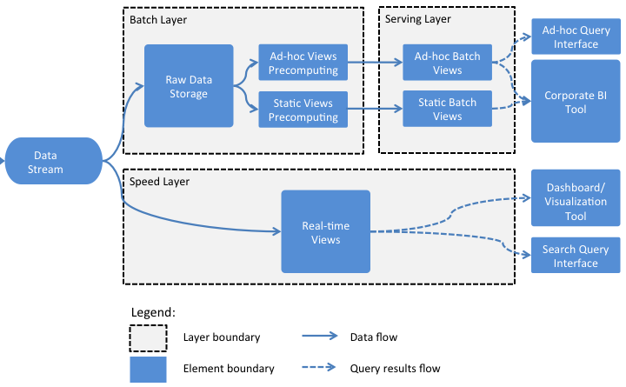
Example Sketch and Responsibilities
Element | Responsibility
Data Stream | This element collects data from all data sources in real-time and dispatches it to both the Batch Layer and the Speed Layer for processing.
Batch Layer | This layer is responsible for storing raw data and pre-computing the Batch Views to be stored in the Serving Layer.

Slide 96
Recording Design Decisions
In each design iteration, you make important design decisions to achieve your iteration goal. These design decisions include:
Selecting a design concept from several alternatives
Creating structures by instantiating the selected design concept
Establishing relationships between elements and defining interfaces
Allocating resources (people, hardware, computation, etc.)
Others

Slide 97
Recording Design Rationale
Recording design decisions beyond the elements, relationships, and properties is fundamental to help others understand how you arrived at the result: the design rationale.

Slide 98
Recording Design Rationale
Some information that can be useful to record includes:
What evidence was produced to justify decisions?
Who did what?
Why were shortcuts taken?
Why were tradeoffs made?
What assumptions did you make?

Slide 99
Tracking Design Progress
When you are performing design, however, there are several questions that you want to answer:
How much design do we need to do?
How much design has been done so far?
Are we finished?
Agile practices such as the use of backlogs and kanban boards can help you track the design progress and answer these questions.
Any development project using any methodology, should track progress.

Slide 100
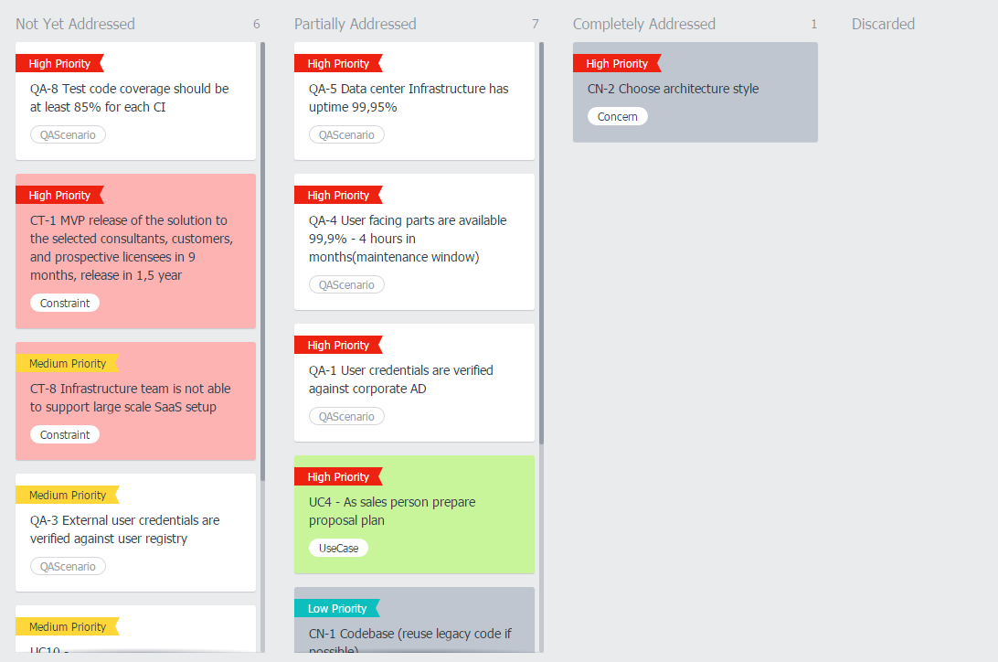
Example Kanban Board

Slide 101
Conclusions
An Architecture reflects a series of decisions
Documenting & depicting decisions as well as reasons is key
Change of a decision is a decision itself
Can generate technical debt
Can (and needs to) undergo rigorous trade-off analysis
With business → ATAM
With everyone → ADD 3

Slide 102
That’s it for today!
Next lecture:
Architecture Design Description Fundamentals;
ISO/IEC 42010 Standard for Architecture Description;
UML as a Software Architecture Specification Language;

Slide 103
References
[1] Shriver, Ryan. “Seven Strategies for Technical Debt”. (2009). www.projectmanagement.com (former www.gantthead.com)
[2] Allman, Eric. “Managing Technical Debt. (2012). ISSN 1542-7730. Queue – Development Magazine Volume 10 Issue 3, March 2012 pp 10-17. New York – USA.
[3] Eisenberg, Robert. (2012). ACM SIGSOFT Software Engineering Notes, ISSN 0163-5948. March 2012, Volume 37, Issue 2 pp 1-6.
[4] www.sonarsource.org
[ATAM] Kazman, Rick, Klein, Mark and Clements, Paul ATAM: Method for Architecture Evaluation. (CMU/SEI-2000-TR-004) , Carnegie Mellon Uiversity, Software Engineering Institute (2000). .

